Slide 1



The First Affiliated Hospital with Nanjing Medical University
PANCREAS CENTER
Predictors of distinct weight trajectories after resection for pancreatic cancer: a prospective cohort study
Lei Cui, Xiaoping Fang, Kuirong Jiang, Yi Miao, Huiping Yu,
Qingmei Sun, and Jishu Wei
Pancreas Center, First Affiliated Hospital with Nanjing Medical University, Nanjing, China
Contact: jsphcl@163.com（Cui, L.）

Slide 2


OUTLINE
01
BACKGROUND
02
METHODS
03
RESULTS
04
CONCLUSION

Slide 3
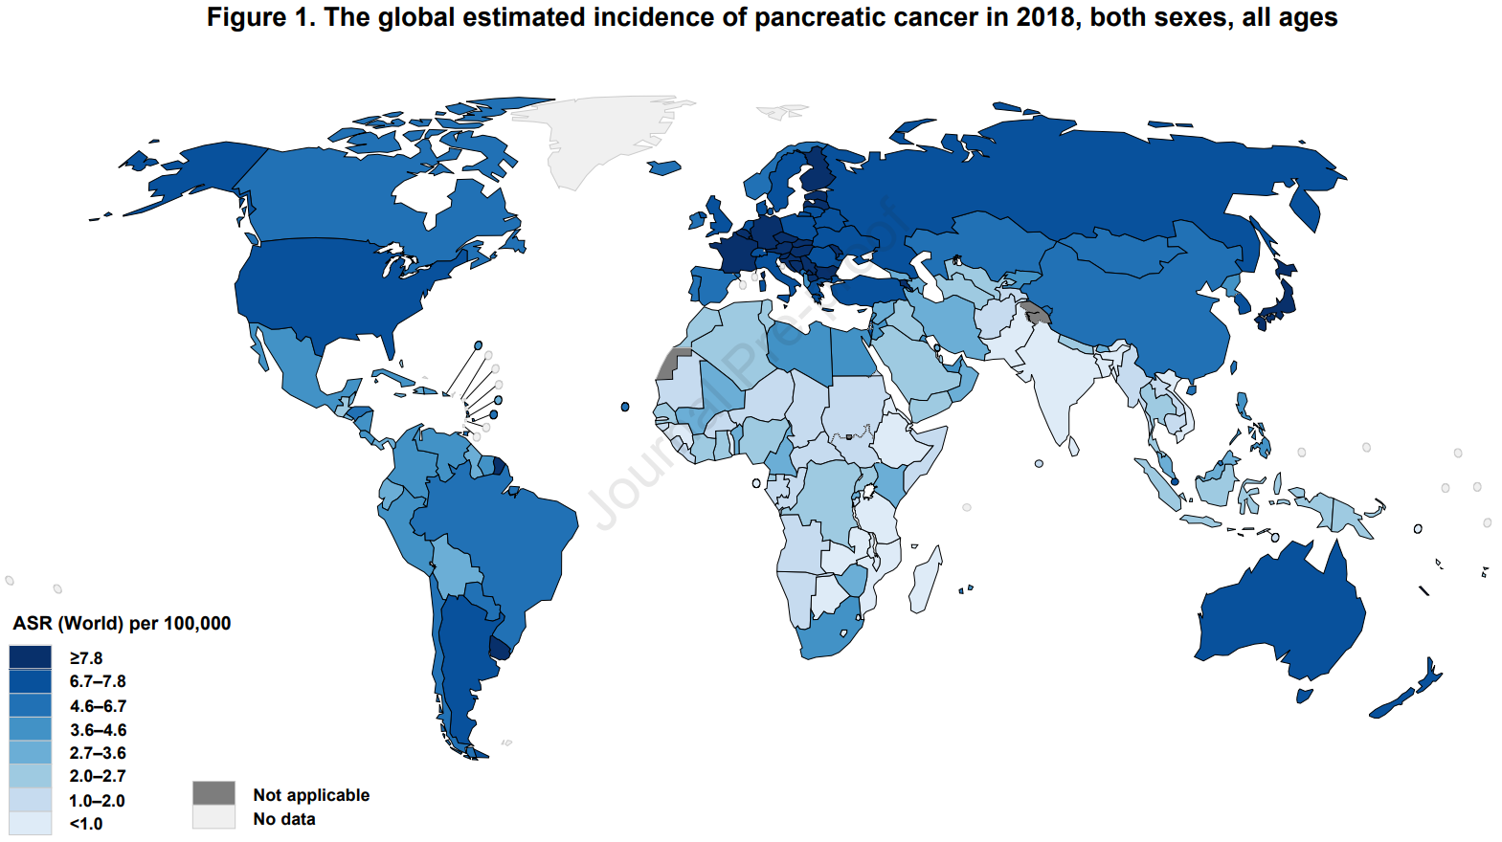
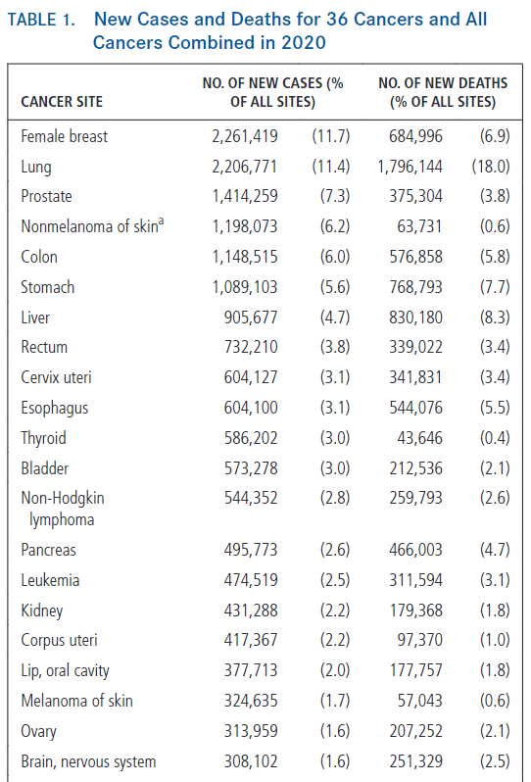
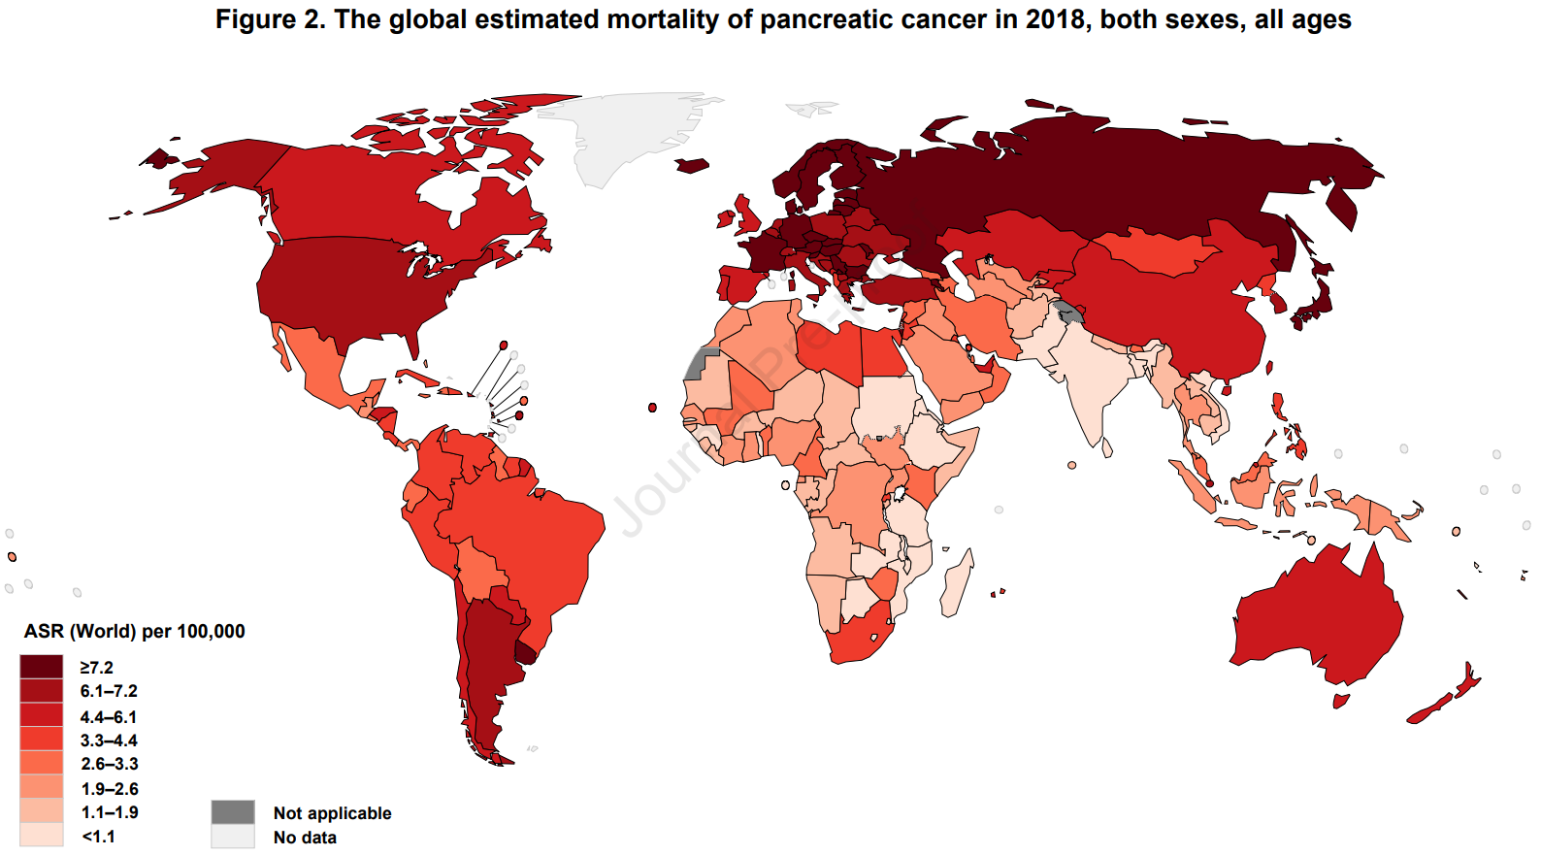
BACKGROUND
Epidemiology of pancreatic cance
Pancreatic cancer is the seventh leading cause of cancer-related mortality worldwide.
Resection combined with adjuvant chemotherapy offers the only chance for a cure for pancreatic cancer.
PANCREAS
CENTER
CA Cancer J Clin,2021,71(3):209-49; Gastroenterology,2021,160(3):744-54

Slide 4
BACKGROUND
Body weight is often used to assess patients’ postoperative recovery and guide nutritional interventions.
01
Low therapeutic tolerance
Nutritional support has been widely considered to maintain or restore body weight.
Anorexia
02
Reduced quality of life
03
Malabsorption
Cachexia
Reduced overall mortality
Nearly half of patients with early and locally advanced pancreatic cancer lose weight before surgery, and 80% of patients experience progressive weight loss after surgery.
Support Care Cancer, 2013, 21(1): 219-27; Support Care Cancer, 2011, 19(11): 1729-34; J Gastrointest Oncol, 2018, 9(1): 17-23; J Gastrointest Surg, 2008, 12(7): 1193-201; Nutrition, 2019, 67-68: 110539; Cancer Med, 2016, 5(4): 607-16; Eur J Surg Oncol, 2023, S0748-7983(23): 00431-6; Surgery, 2018, 164(5): 1035-48

Slide 5
BACKGROUND
Full recognition and early identification of weight loss are an essential part in the process of nutritional support.
There have been very few retrospective cohort articles involving weight loss after pancreatectomy.
Limitations
Trudeau et al.,
Reporting weight changes and associated factors in 1,090 patients at one year after pancreatectomy
No representation of
the Chinese population
Small sample size
Only considering factors that affect weight changes during hospitalization Not entirely representing the characteristics of pancreatic cancer, due to using mixed study subjects
This prospective cohort study focuses on Chinese patients with pancreatic cancer undergoing pancreatectomy; it collects perioperative and post- discharge parameters in order to determine the weight change and its predictors six months after surgery.
Hashimoto et al.,
Investigating the impact of weight loss, four months after surgery, on survival in 93 patients after resection for pancreatic cancer
Assessing the weight loss percentage and factors associated with sustained weight loss in 262 patients undergoing hepato-pancreato-biliary surgical resections
Zhang et al.,
BMC Cancer, 2014, 14: 593; Surgery, 2020,168(6):1041-7; JPEN J Parenter Enteral Nutr,2015, 39(5):598-603; Surg Innov,2022,29(2):195-202

Slide 6
Methods
Study Design and Participants
Study design: a prospective cohort study
Participants: From February 2022 to July 2022, we consecutively enrolled patients with newly diagnosed pancreatic cancer who were to undergo pancreatectomy in our center.
Inclusion criteria
combined with any
other malignant tumour
failed to provide preoperative or 6-month postoperative weight
died within six months after surgery
aged ≥ 18 years old
histopathological
diagnosis of ductal
adenocarcinoma
undergoing radical resection
Exclusion criteria
PANCREAS

Slide 7
Methods
Data Collection
Data during hospitalization were derived from patients’ self-reports or electronic medical records.
Post-discharge information was collected from patient self-reports.
Intraoperative
data
Baseline and preoperative information
Preoperatively
(within 3 d before surgery)
3 m (±1 w) after surgery
Weight data collection
Follow-up data after discharge
Postoperative
information
1 m (±1 w) after surgery
6 m (±1 w)
after surgery

Slide 8


Methods
Statistical Analysis
Categorical variables were expressed as counts and proportions, and continuous variables were reported as medians and interquartile ranges (IQR) because they showed a non-normal distribution.
A Chi-squared test or Fisher’s exact test were used to analyse categorical variables, and the Wilcoxon rank-sum test was employed for continuous variables to compare parameters between patient subgroups.
Univariable and multivariable analyses were conducted using logistic regression to evaluate predictors for various weight trajectories. Variables that were significant in univariable analyses were included in multivariable models.
Missing data were considered to be randomly lost.
All analyses were performed using SPSS software version 26.0 (IBM Corporation), with a two-tailed P < 0.05 regarded as statistically significant.

Slide 9
RESULTS
Sample Selection
Potential participants n=252
Excluded participants n=22:
Coexisting other malignancies (n=8)
Occurrence of metastasis (n=9)
Did not consent (n=5)
Eligible participants n=230
Participation at baseline n=230
Participants at baseline
(preoperation)
n=230
Participants at 1st wave
(1-month postoperation)
n=227
Participants at 2nd wave
(3-month postoperation)
n=223
Participants at 3rd wave
(6-month postoperation)
n=197
Death n=0
non-response to weight data n=0
Death n=3
non-response to weight data n=0
Death n=4
non-response to weight data n=0
Death n=10
non-response to weight data n=16
Longitudinal sample with complete data (at least responses to baseline and 3rd wave data collections) n=197
Losses to follow-up (non-response to baseline and 3rd wave data collections or death) n=33
Fig. 1 The sample selection, response, wave non-response and timing of follow-ups at each stage

Slide 10
RESULTS
Sample Characteristics
Table 1 participants’ Characteristics(n=197)
Continued table
Variable, n (%) or median (IQR) | Overallseries(n=197)
Preoperative
Age (years) | 63.0(56.0-69.5)
Male | 126(64.0)
ASA 3&4 | 44(22.3)
History of smoking | 36(18.3)
History of alcohol | 20(10.2)
Neoadjuvant therapy | 7(3.6)
Preoperativeweight loss > 10% | 34(17.3)
BMI ≥ 24 kg/m² | 80(40.6)
Diabetes mellitus | 58(29.4)
Hypertension | 76(38.6)
Coronary heart disease | 6(3.0)
History of stroke | 11(5.6)
Intraoperative
Type of procedure
Distal pancreatectomy | 75(38.1)
Pancreatoduodenectomy | 115(58.4)
Total pancreatectomy | 7(3.6)
Operative technique
Open | 183(92.9)
Laparoscopic | 14(7.1)
Combined visceral resection | 25(12.7)
Blood transfusion | 27(13.7)
Operative time (min) | 255.0(185.0-314.5)
AJCC^{8th}TNM stage
I | 46(23.4)
II | 86(43.7)
III | 65(33.0)
Postoperative
Hemorrhage | 8(4.1)
CR-DGE | 21(10.7)
CR-POPF | 51(25.9)
Biliary leakage | 1(0.5)
Chyle leakage | 26(13.2)
Intra-abdominal infection | 20(10.2)
After discharge
Home enteral nutrition | 7(3.6)
Steatorrhea | 27(13.7)
PERT | 194(98.5)
Abbreviations: AJCC^{8th}, the 8th edition of the American Joint Committee on Cancer classification; CR-DGE, clinically relevant delayed gastric emptying; CR-POPF, clinically relevant postoperative pancreatic fistula;PERT, pancreatic enzyme replacement therapy.

Slide 11
RESULTS
Weight Trajectories after Pancreatectomy
Postoperative percentage weight change (PWC) was defined by calculating the percentage of weight lost six months after surgery, from each patient’s original preoperative weight.
Percentage change in weight
Fig. 2 Percentage change in weight from baseline in overall cohort
Fig. 3 Percentage change in weight from baseline, stratified into 3 groups: distal pancreatectomy (DP), Pancreatoduodenectomy (PD), and total pancreatectomy (TP)
Fig. 4 Percentage change in weight from baseline, stratified into 3 groups: AJCC^{8th} TNM stage I, II and III
Only 33 (16.8%) patients regained or surpassed their preoperative weight six months postoperatively. In contrast, nearly half of the patients (48.2%) lost more than 10% of their preoperative weight six months after surgery.

Slide 12
RESULTS
Factors Associated with Weight Restoration
The weight restoration cohort was defined as the top quartile of weight change six months after surgery.
Table 2 Factors associated with weight restoration at 6 months
Continued table
Table 3 Multivariable analysis for weight restoration
Variable, n (%) or median (IQR) | Weight restoration |  | P
 | Yes n=49 | No n=148
Preoperative
Age (years) | 60.0(54.5-67.5) | 64.0(56.0-70.0) | 0.249
Male | 35(71.4) | 91(61.5) | 0.209
ASA 3&4 | 11(22.4) | 33(22.3) | 0.982
History of smoking | 10(20.4) | 26(17.6) | 0.656
History of alcohol | 4(8.2) | 16(10.8) | 0.595
Neoadjuvant therapy | 0(0.0) | 7(4.7) | 0.269
Preoperative weight loss > 10% | 6(12.2) | 28(18.9) | 0.284
BMI ≥ 24 kg/m² | 12(24.5) | 68(45.9) | 0.008
Diabetes mellitus | 16(32.7) | 42(28.4) | 0.569
Hypertension | 15(30.6) | 61(41.2) | 0.186
Coronary heart disease | 1(2.0) | 5(3.4) | 1.000
History of stroke | 1(2.0) | 10(6.8) | 0.375
Intraoperative
Type of procedure |  |  | 0.043
Distal pancreatectomy | 26(53.1) | 49(33.1)
Pancreatoduodenectomy | 22(44.9) | 93(62.8)
Total pancreatectomy | 1(2.0) | 6(4.1)
Operative technique |  |  | 1.000
Open | 46(93.9) | 137(92.6)
Laparoscopic | 3(6.1) | 11(7.4)
Combined visceral resection | 10(20.4) | 15(10.1) | 0.061
Blood transfusion | 4(8.2) | 23(15.5) | 0.193
Operative time (min) | 237.0(150.0-292.5) | 257.5(207.3-322.8) | 0.016
AJCC8thTNM stage |  |  | 0.006
I | 8(16.3) | 38(25.7)
II | 31(63.3) | 55(37.2)
III | 10(20.4) | 55(37.2)
Postoperative
Hemorrhage | 4(8.2) | 4(2.7) | 0.207
CR-DGE | 4(8.2) | 17(11.5) | 0.514
CR-POPF | 15(30.6) | 36(24.3) | 0.384
Biliary leakage | 0(0.0) | 1(0.7) | 1.000
Chyle leakage | 2(4.1) | 24(16.2) | 0.030
Intra-abdominal infection | 7(14.3) | 13(8.8) | 0.269
After discharge
Home enteral nutrition | 0(0.0) | 7(4.7) | 0.269
Steatorrhea | 2(4.1) | 25(16.9) | 0.023
PERT | 48(98.0) | 146(98.6) | 1.000
Variable | OR (95% CI) | P
BMI < 24 kg/m² | 2.781(1.281-6.040) | 0.010
Type of procedure
Distal pancreatectomy | REF
Pancreatoduodenectomy | 0.408(0.199-0.837) | 0.014
Total pancreatectomy | 0.344(0.036-3.307) | 0.355
Operative time (min) | NA
AJCC8thTNM stage
I | 1.214(0.419-3.517) | 0.721
II | 2.931(1.260-6.814) | 0.013
III | REF
Chyle leakage | 0.184(0.040-0.851) | 0.030
Steatorrhea | NA
Abbreviations: AJCC^{8th}, the 8th edition of the American Joint Committee on Cancer classification; CR-DGE, clinically relevant delayed gastric emptying; CR-POPF, clinically relevant postoperative pancreatic fistula;PERT, pancreatic enzyme replacement therapy.

Slide 13
RESULTS
Factors Associated with Persistent Weight Loss
The persistent weight loss cohort was defined as the bottom quartile of weight change six months after surgery.
Table 4 Factors associated with persistent weight loss at 6 months
Continued table
Table 5 Multivariable analysis for persistent weight loss
Variable, n (%) or median (IQR) | Persistentweight loss |  | P
 | Yes n=49 | No n=148
Preoperative
Age (years) | 64.0(56.0-70.0) | 63.0(56.3-69.0) | 0.657
Male | 32(65.3) | 94(63.5) | 0.821
ASA 3&4 | 13(26.5) | 31(20.9) | 0.416
History of smoking | 10(20.4) | 26(17.6) | 0.656
History of alcohol | 5(10.2) | 15(10.1) | 0.989
Neoadjuvant therapy | 2(4.1) | 5(3.4) | 1.000
Preoperative weight loss > 10% | 9(18.4) | 25(16.9) | 0.813
BMI ≥ 24 kg/m² | 23(46.9) | 57(38.5) | 0.298
Diabetes mellitus | 10(20.4) | 48(32.4) | 0.109
Hypertension | 23(46.9) | 53(35.8) | 0.165
Coronary heart disease | 2(4.1) | 4(2.7) | 0.640
History of stroke | 1(2.0) | 10(6.8) | 0.375
Intraoperative
Type of procedure |  |  | 0.019
Distal pancreatectomy | 12(24.5) | 63(42.6)
Pancreatoduodenectomy | 33(67.3) | 82(55.4)
Total pancreatectomy | 4(8.2) | 3(2.0)
Operative technique |  |  | 1.000
Open | 46(93.9) | 137(92.6)
Laparoscopic | 3(6.1) | 11(7.4)
Combined visceral resection | 1(2.0) | 24(16.2) | 0.010
Blood transfusion | 11(22.4) | 16(10.8) | 0.040
Operative time (min) | 270.0(225.0-348.0) | 246.5(171.3-308.8) | 0.025
AJCC8thTNM stage |  |  | 0.039
I | 13(26.5) | 33(22.3)
II | 14(28.6) | 72(48.6)
III | 22(44.9) | 43(29.1)
Postoperative
Hemorrhage | 2(4.1) | 6(4.1) | 1.000
CR-DGE | 7(14.3) | 14(9.5) | 0.343
CR-POPF | 11(22.4) | 40(27.0) | 0.526
Biliary leakage | 0(0.0) | 1(0.7) | 1.000
Chyle leakage | 3(6.1) | 23(15.5) | 0.091
Intra-abdominal infection | 5(10.2) | 15(10.1) | 0.989
After discharge
Home enteral nutrition | 1(2.0) | 6(4.1) | 0.830
Steatorrhea | 14(28.6) | 13(8.8) | 0.001
PERT | 49(100.0) | 145(98.0) | 0.315
Variable | OR (95% CI) | P
Type of procedure
Distal pancreatectomy | NA
Pancreatoduodenectomy | NA
Total pancreatectomy | NA
Combined visceral resection | 0.102(0.013-0.814) | 0.031
Blood transfusion | 2.580(1.028-6.474) | 0.044
Operative time (min) | NA
AJCC^{8th}TNM stage
I | NA
II | NA
III | NA
Steatorrhea | 3.528(1.489-8.355) | 0.004
Abbreviations: AJCC^{8th}, the 8th edition of the American Joint Committee on Cancer classification; CR-DGE, clinically relevant delayed gastric emptying; CR-POPF, clinically relevant postoperative pancreatic fistula;PERT, pancreatic enzyme replacement therapy.
Surgery,2020,168(6):1041-7

Slide 14

Conclusion
The postoperative weight loss of patients with pancreatic cancer is a critical factor, which clinicians should pay attention to.
The most relevant time-point for determining the final weight change trajectory may be at the third postoperative month.
Clinical physicians should use the information to identify patients who keep losing weight, and implement closer nutritional monitoring and intervention to promote their weight regain.

Slide 15

Thanks for
your attention！

