Slide 1


Psychological strategies for cancer patients in clinical trials during the COVID-19 epidemic
Shujun Yin
Fujian Cancer Hospital,
Fuzhou,China

Slide 2

Outline
----Introduction
----Study design
-----Results
-----Psychological strategies
-----Conclusion

Slide 3
Introduction
Novel coronavirus pneumonia (COVID-19) is a lung disease caused by novel coronavirus infection.
During the epidemic of COVID-19, the physical and mental health of cancer patients was greatly challenged.
Physically, they had to worry about the impact of the epidemic on their own condition and treatment. Psychologically, anxiety, depression and other psychological diseases often troubled them.
Cancer patients participating in clinical trials often worry that due to the pandemic, they may violate the trial protocol and may not be able to take medication in time.
The purpose of this paper is to study the psychological status of advanced cancer patients in clinical trials during the outbreak of COVID-19, analyze the influencing factors, and propose coping strategies.

Slide 4
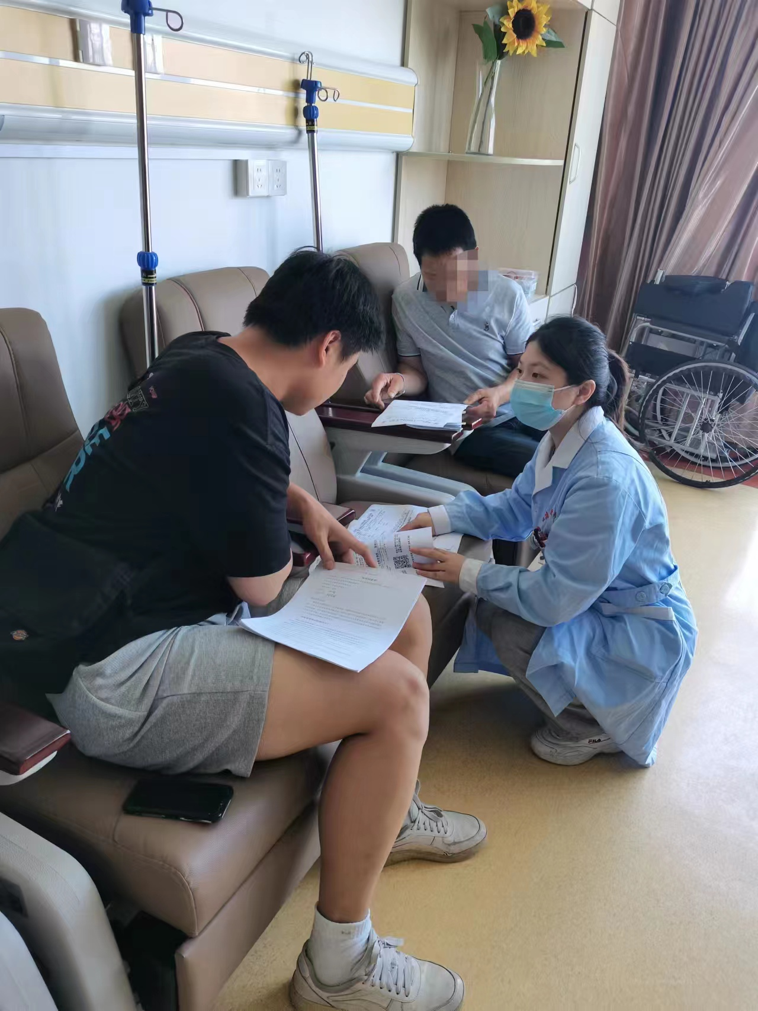
Study design
Research subjects:
• Patients diagnosed with cancer through cytology or pathology and enrolled in tumor clinical trials
• Age ≥ 18 years old
• No history of cognitive impairment and mental illness
Research methods:
The Symptom Checklist 90 (SCL-90) was used as a measurement tool, consisting of 90 items and divided into 9 factors.
Positive screening criteria:
• total score exceeds 160 points，
• or the number of positive items exceeds 43，
• or any factor score exceeds 2 points.
Statistical analysis:
SPSS 27.0 software was used for analysis.

Slide 5
Demography characteristics
 | Number（n=60） | %
Sex
Male | 39 | 65.0
Female | 21 | 35.0
Age
＜50years | 25 | 41.7
≥50years | 35 | 58.3
Education
Junior high school and below | 39 | 65.0
Senior high school and above | 21 | 35.0
Tumor type
Lung cancer | 30 | 50.0
Other tumors | 30 | 50.0
Marital status
Married | 47 | 78.3
Single | 13 | 21.7
Career
Physical worker | 36 | 60.0
Mental worker | 24 | 40.0

Slide 6
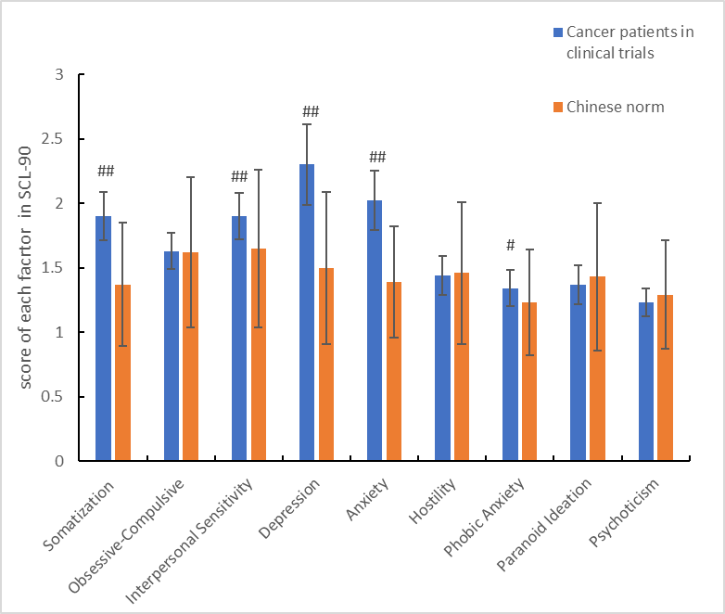
Comparison of SCL-90 with Chinese norm
Note: Compared with the Chinese norm（n=1388）, # P<0.05, # # P<0.01

Slide 7
Single factor analysis of SCL-90 positive results
Factors |  | n | Positive patients/n | positive rate/% | χ2 | P
Sex | Male | 39 | 32 | 82.1 | 0.908 | 0.533
 | Female | 21 | 15 | 71.4
Age | ＜50years | 25 | 18 | 72.0 | 1.013 | 0.314
 | ≥50years | 35 | 29 | 82.9
Education | Junior high school and below | 39 | 34 | 87.2 | 5.138 | 0.053
 | Senior high school and above | 21 | 13 | 61.9
Tumor type | Lung cancer | 30 | 29 | 96.7 | 11.882 | <0.001
 | Other tumors | 30 | 18 | 60.0
Marital status | Married | 47 | 38 | 80.9 | 0.810 | 0.603
 | Single | 13 | 9 | 69.2
Career | Physical worker | 36 | 30 | 83.3 | 1.326 | 0.250
 | Mental worker | 24 | 17 | 70.8
Severity of adverse reactions | Grade Ⅰ～Ⅱ | 23 | 14 | 60.9 | 6.702 | 0.023
 | Grade Ⅲ～Ⅳ | 37 | 33 | 89.2
Delayed medication by the epidemic in clinical trials. | Yes | 36 | 32 | 88.9 | 5.908 | 0.015
 | No | 24 | 15 | 62.5

Slide 8
Multivariate logistic regression analysis of SCL-90 positive results
Influence factors | B | SE | Wardχ² | P | OR(95%CI)
Education | 0.314 | 0.706 | 0.197 | 0.657 | 1.368(0.343～5.461)
Tumor type | -3.184 | 1.169 | 7.421 | 0.006 | 0.041(0.004～0.409)
Severity of adverse reactions | 2.195 | 0.708 | 9.623 | 0.002 | 8.984(2.244～35.966)
Delayed medication by the epidemic in clinical trials. | 1.352 | 0.612 | 4.883 | 0.027 | 3.866(1.165～12.829)

Slide 9
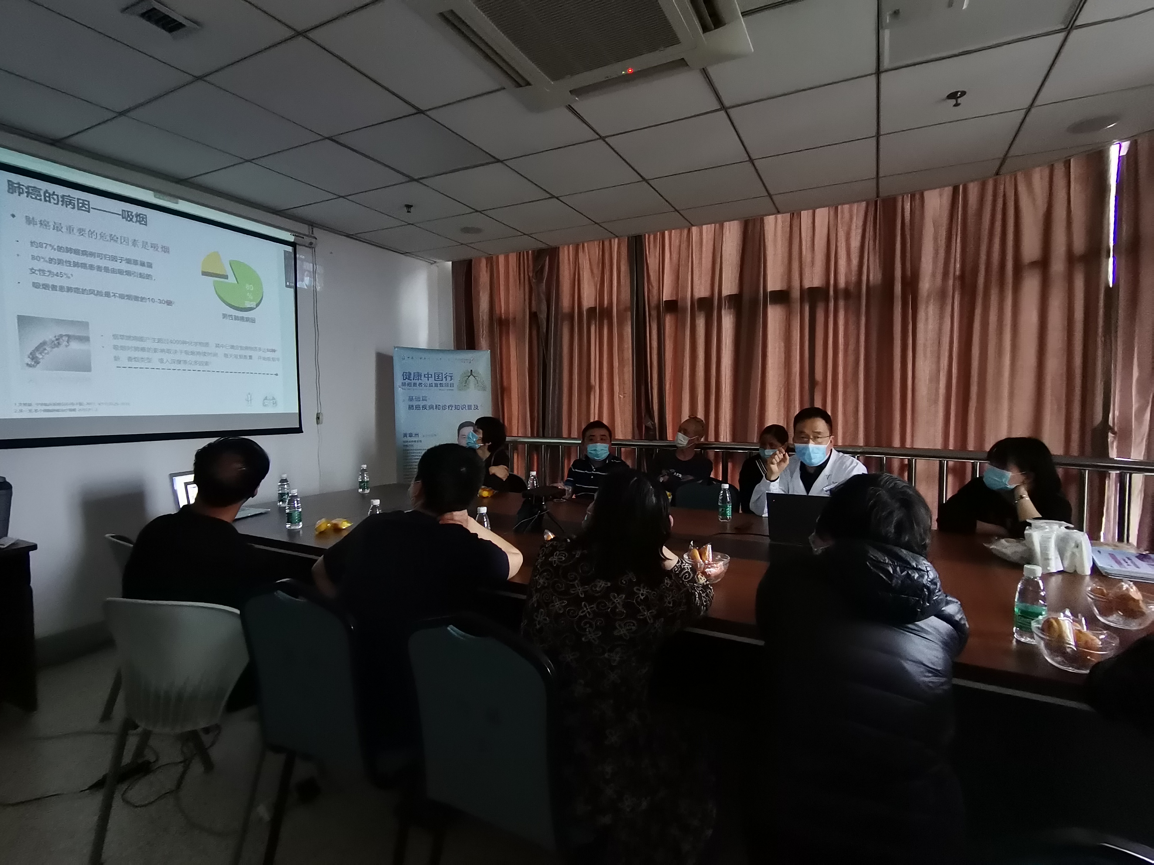
Psychological strategies
Experts give popular science lectures for lung cancer patients:The patients and their families were carried out scientific popularization of COVID-19 pneumonia related knowledge, with special emphasis on the difference between the respiratory symptoms caused by lung cancer and COVID-19 pneumonia.Inform patients and their families of adverse reactions to clinical trial drugs, and enable them to understand relevant medical knowledge, so as to have a clear understanding and stabilize emotions. When adverse reactions of experimental drugs occur, patients can be guided to actively respond and handle them through WeChat, phone, etc., and the treatment plan can be adjusted according to the patient's situation.
Ice-breaking link: In group, we suggest to strengthen communication and interaction between patients' family members, and share treatment experience with each other.

Slide 10
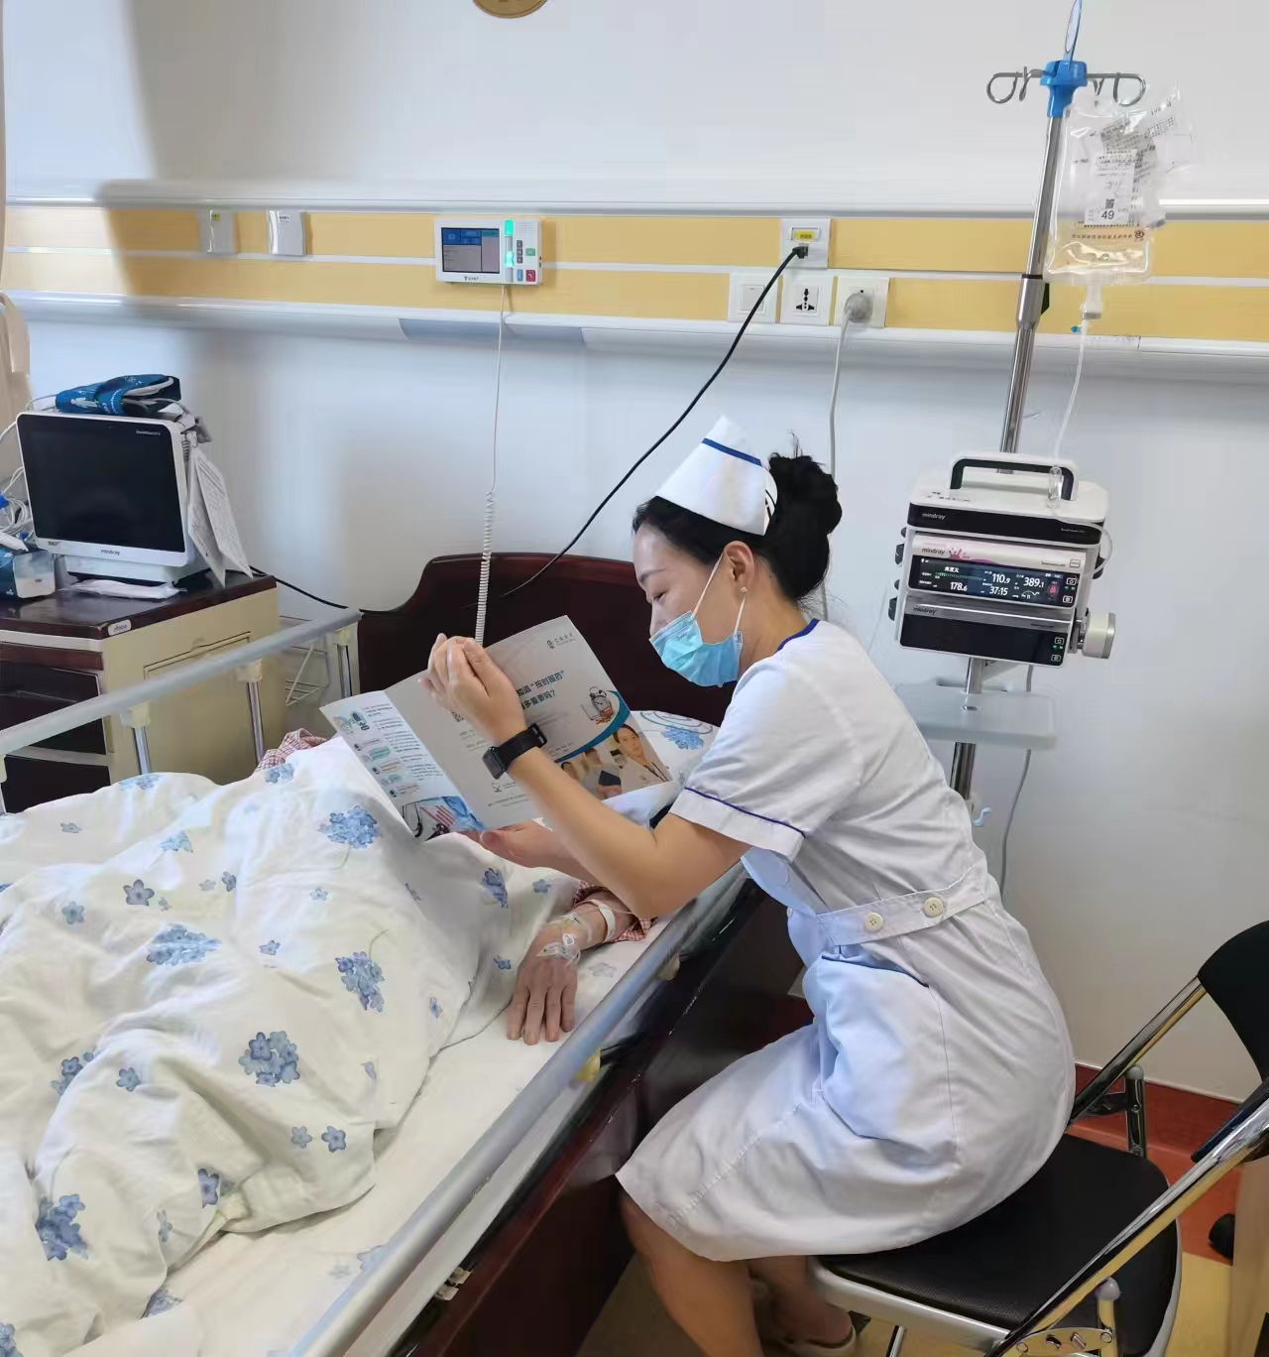
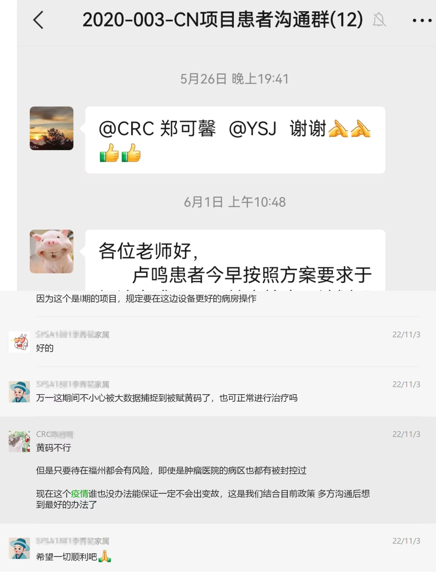
Psychological strategies
Encourage to talk: patients can talk to each other, comfort, and help each other in life when they have bad feelings.
Set up wechat help group: patients can have psychological communication, questions and consultation in the group, and the nurses will send related popular science knowledge and psychological adjustment methods in the group regularly.

Slide 11
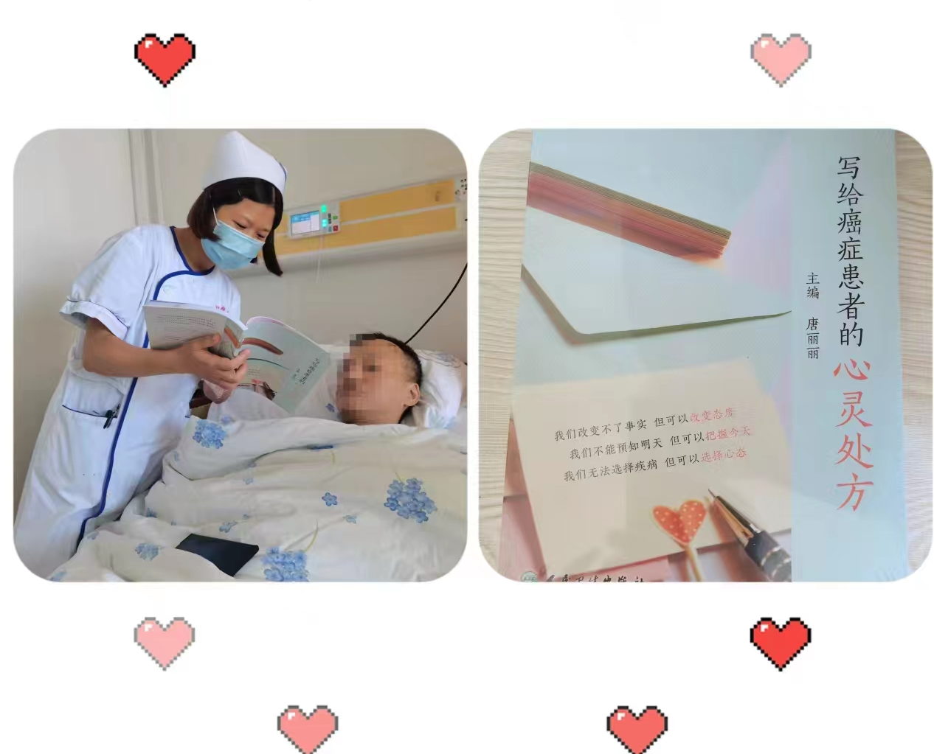
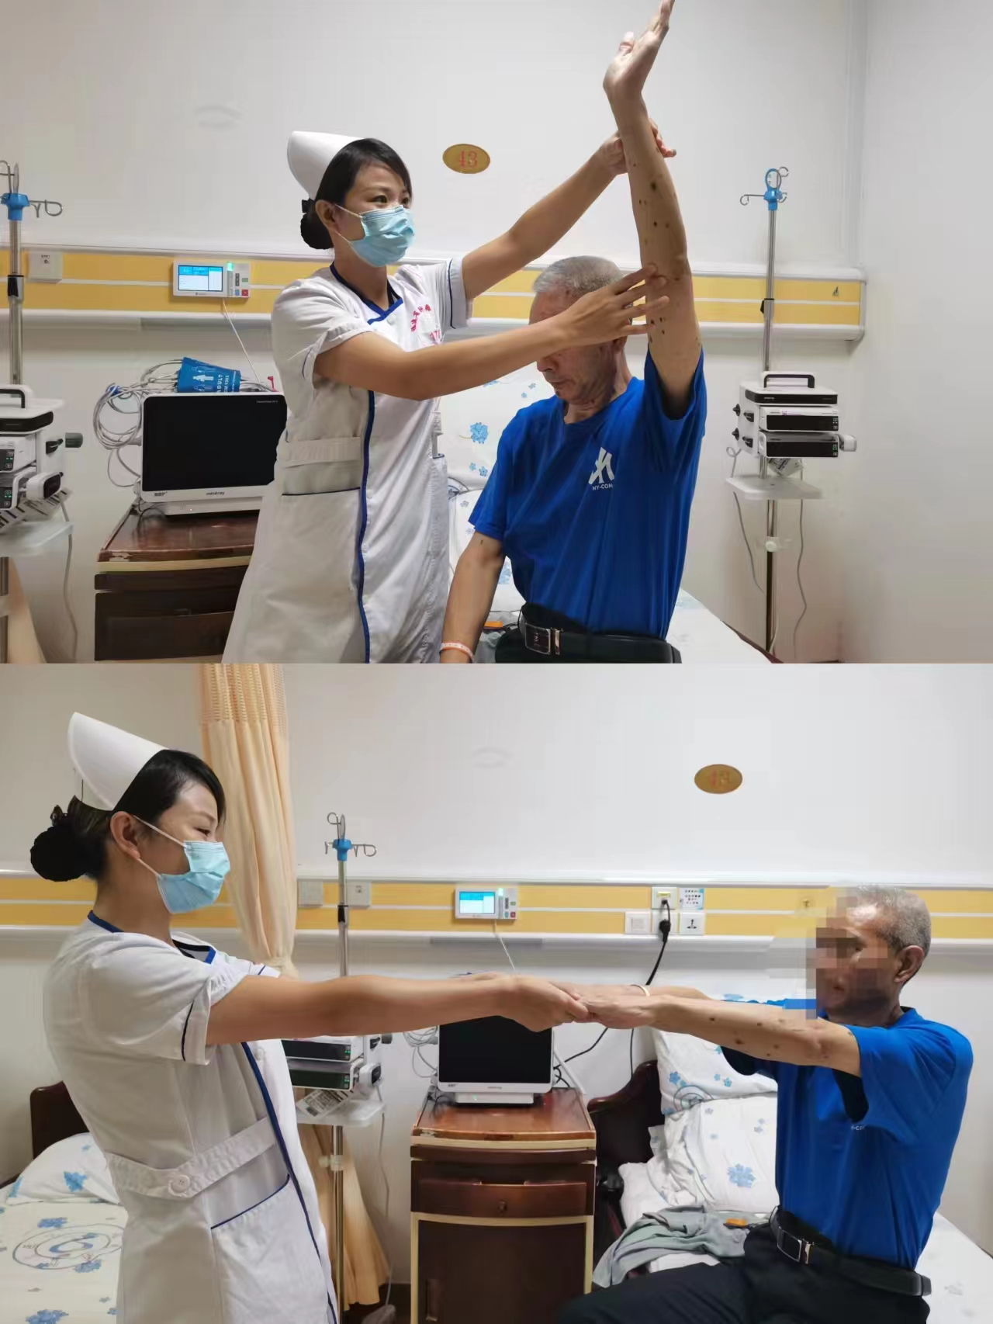
Psychological strategies
Set up a spiritual workshop: regularly read books about spiritual prescriptions with patients to music, instruct patients to relax their limbs, exercise properly, and improve their mood.

Slide 12
Conclusion
During the COVID-19, most advanced cancer patients in clinical trials had psychological stress reactions, which were closely related to tumor types, Severity of adverse reactions, and delayed medication by the epidemic in clinical trials.
Nurses should strengthen psychological care and humanistic care for patients during this special period, so as to reduce their psychological stress, improve their compliance, and prevent patients from falling off during the study.

Slide 13

To cure sometimes, to relieve often,
to comfort always。
—— Trudeau

Slide 14
THANKS FOR YOUR ATTENTION !

