Slide 1



Efficacy of follow-up support based on an information system for outpatients with cancer pain on pain relief，analgesic adherence and constipation
Hong YANG, Xiaoxiao MA, Shiyi ZHANG, Jinxing SHAO, Xin LI, Lihua HAO,
Hong ZHANG, Fanxiu HENG, Yuhan LU (Corresponding author)
Peking University Cancer Hospital & Institute

Slide 2

Introduction
Pain is a very common distressing symptom among cancer patients, and it is generally the result of tissue damage caused by the disease and/or cancer treatment
Cancer pain management needs to be extended beyond the hospital setting
There are a number of challenges that have to be addressed for the provision of effective pain management medication outside the hospital setting
The novel coronavirus disease 2019 (COVID-19) is an ongoing pandemic that has impacted the entire world
In recent years, several web-based, and mobile-based model of follow-up support have been developed to facilitate pain management on an outpatient basis in China
Notes:
The main advantage of these systems is that they facilitate the continuous digital reporting of pain relief from a patient's perspective.

Slide 3
Objective
We developed and implemented a nurse-led follow-up information system to facilitate the pain management of cancer patients on an outpatient basis
The purpose of this study aimed to describe the symptoms that are a direct result of outpatients’ follow-up support based on an information system: pain relief, analgesic adherence and constipation experienced by cancer outpatients with pain.

Slide 4
Methods
Participants
A cluster sampling of patients enrolled in the study received at least three follow-up cycles between 1 July 2020 and 31 March 2022
The inclusion and exclusion criteria
The patients with acute pain such as those caused by surgery , patients or caregivers who could not master the use of this follow-up information system after guidance should be excluded.
cancer diagnosis
discharged from the cancer hospital required opioid treatment for pain management
consented to participate in this study
Sample size: GPower3.1 , required sample size n=198

Slide 5
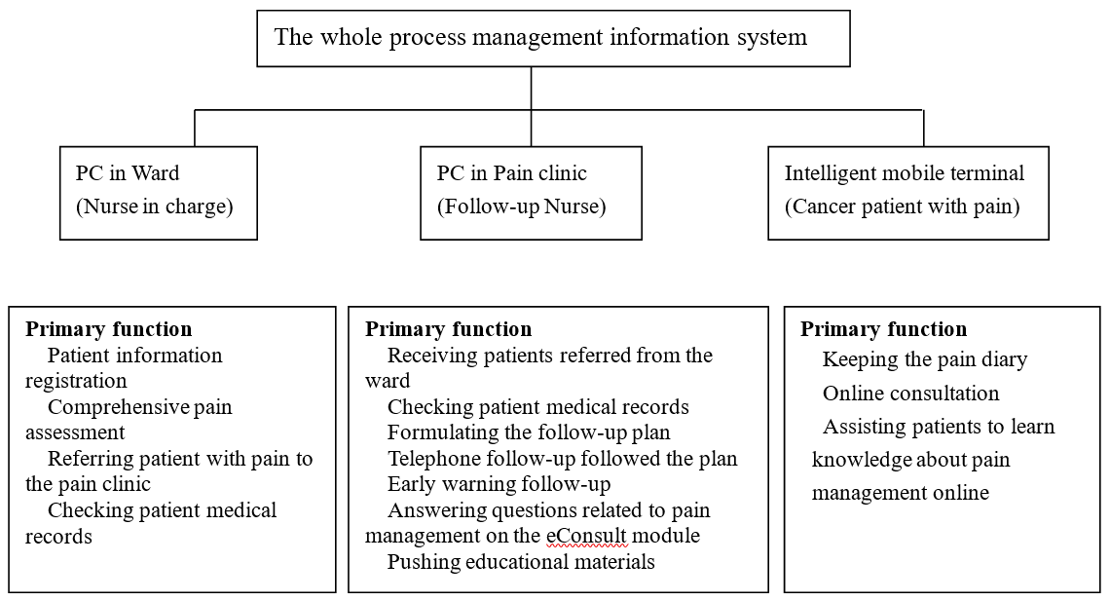
Methods
Intervention
Developed an information system for the whole process management of cancer patients with pain
Discharge preparation
Out-of-hospital management
Notes:
The whole process management information consists of three functional modules. PC in ward for the charge nurse to make discharge preparation, PC in pain clinic for the trained nurse to provide follow-up for discharged patients, and intelligent mobile terminal for the outpatients to record pain diary and online consultation.

Slide 6
Methods
Measurements
NRS was rated the pain from 0 to 10. NRS was used to assess the efficacy of the follow-up support on pain relief, whereby a score of three or less represents complete pain relief, and a score above three represents incomplete pain relief.
Compliance to analgesic treatment was measured through the patient self-reported about their drug intake
Constipation was defined based on the Rome IV criteria, as reduced frequency of spontaneous defecation (no defecation for 3 days or more), dry stool, and difficulty in defecation, accompanied by abdominal distension and pain.

Slide 7

Methods
The sociodemographic and clinical data were retrieved from the patient's medical records.
The outcomes of patient's pain relief, analgesic adherence, and constipation were retrieved from the information system.

Slide 8

Results
A total of 386 patients from 26 provinces, municipalities, and autonomous regions in China were included in the study.
The average age was 60.24 ± 11.70 years (range: 24-88 years).
The majority of patients were male (62.69%).
Most patients were diagnosed with lung cancer (40.42%) or gastrointestinal cancer (37.56%).

Slide 9
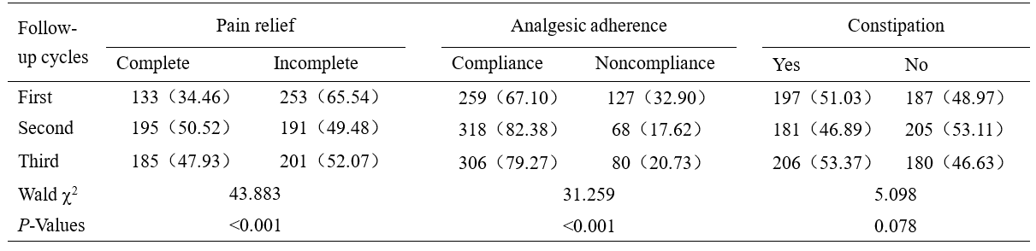
Results
Pain relief The complete and incomplete rates for the pain relief differed significantly between the three follow-up cycles (P<0.001).
Compliance with analgesic treatment The compliance and noncompliance rates for the analgesic treatment differed significantly (P<0.001).
Constipation The incidence of constipation between the three follow-up cycles did not differ significantly.

Slide 10
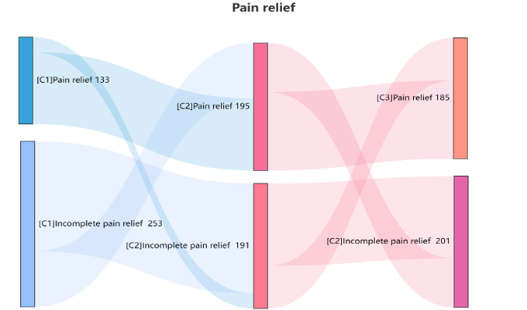
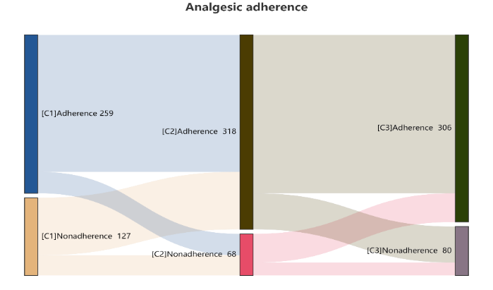
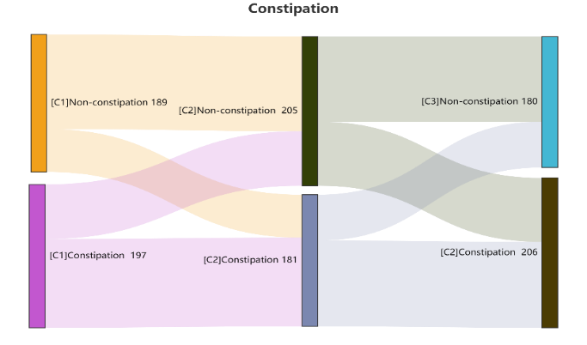
Results
- The changes in treatment outcomes over time are illustrated in the Sankey chart

Slide 11
Discussion
We evaluated the efficacy of follow-up support based on information system on pain relief, compliance with treatment, and alleviating adverse drug-related side effects in cancer patients following three cycles of remote follow-up support.
Compared with the first follow-up cycle, the pain relief, analgesic adherence, and management of constipation improved considerably in the second follow-up cycle.
Some patients with complete pain relief, good analgesic adherence, and no constipation after the first or second cycle reported incomplete pain relief, poor analgesic adherence, and constipation in the next follow-up cycle.

Slide 12
Discussion
The follow-up nurses in our program have an important role in ensuring that the patients comply with the pain management treatment plan and in adapting the plan based on the patient's needs.
Advantages:
This system allowed healthcare professionals to continuously adapt the pain management information according to the patient's current needs on an outpatient basis.
The pain diary provided the nurses with longitudinal data, making it easier for the nurses to adapt the treatment for the patient.
The continuous and structured follow-up records based on the information system also provide important data that could be used for research purposes.

Slide 13
Conclusions
Cancer outpatients with pain reported increasing pain relief, analgesic adherence during the follow-up support based on information system.
In comparison with rates at first and third cycles, pain relief analgesic adherence were best second cycle during the follow-up support based on information system.
Changes in pain intensity, analgesic adherence, and constipation were noted over time, highlighting the need for continuous follow-up to achieve prolonged pain relief in cancer patients after being discharged from the hospital.

Slide 14
References
International Association for the Study of Pain. IASP terminology. Pain terms. Available at: https://www.iasp-pain.org/terminology?navItemNumber=576#Pain. Accessed 18 Octo, 2022.
van den Beuken-van Everdingen MH, Hochstenbach LM, Joosten EA, Tjan-Heijnen VC, Janssen DJ (2016) Update on Prevalence of Pain in Patients With Cancer: Systematic Review and Meta-Analysis. J Pain Symptom Manage 51(6):1070-1090.e9.
Evenepoel M, Haenen V, De Baerdemaecker T, Meeus M, Devoogdt N, Dams L, Van Dijck S, Van der Gucht E, De Groef A (2022) Pain Prevalence During Cancer Treatment: A Systematic Review and Meta-Analysis. J Pain Symptom Manage 63(3):e317-e335.
Bruera E, Kim HN (2003) Cancer pain. JAMA 12;290(18):2476-9.
Sung H, Ferlay J, Siegel RL, Laversanne M, Soerjomataram I, Jemal A, Bray F (2021) Global Cancer Statistics 2020: GLOBOCAN Estimates of Incidence and Mortality Worldwide for 36 Cancers in 185 Countries. CA Cancer J Clin 71(3):209-249.
……

