Slide 1


The relationship between resilience, social support and health-related quality of life(HRQOL) in female breast
Wang Yishu
West China Hospital of Sichuan University

Slide 2

Introduction
-Incidence
Breast cancer survivors are the largest group of female cancer survivors in the world ^{[1]} . 2021, breast cancer survival rates in every country in the world exceed 80% ^{[2]} .
- ExistingProblems
93% of breast cancer survivors experience one or more health problems within five years ^{[3]}.A retrospective survey of key areas of US cancer patient survival research found that psychological and quality-of-life problems (23%) and psychosocial problems (10%) were at the top ^{[4]}.
Breast cancer survivors are out of the care of hospital staff, follow-up is limited in the country, and some psychological, social and health issues remain to be addressed.

Slide 3
Objective
- To investigate and analyze the status and correlation of psychological resilience, social support, health-related quality of life of breast cancer survivors
- To provide research basis for improving health management of breast cancer survivors

Slide 4
Methods
A cross-sectional survey was conducted on 391 breast cancer survivors who were followed up in West China Hospital of Sichuan University from March 31, 2021 to November 19, 2021.
- Research tools
The general data questionnaire
The Connor-Davidson Resilience Scale (CD-RISC)
The Social Support Rate Scale (SSRS)
The Short Form 36-item Health Survey (SF-36)
- Statistical method
Statistical analysis was performed using IBM SPSS26.0
The counting data were described by frequency (constituent ratio) , and the measuring data were described by mean, standard deviation and median
Spearman was used for correlation analysis
The influencing factors of HRQOL were measured by Regression analysis method
The mediating effect test was measured by Boots method

Slide 5
Results
- Participate
The age of the subjects ranged from 26 to 65 years, with an average age of 47.23 ± 10.13 years,89.26% of them were married, and 84.14% of them lived in cities for a long time.
- Score of CD-RISC,SSRS and SF-36
The mean score for CD-RISC was 68.77 points (s = 14.85, M = 68.00)
The mean score for SSRS was 41.42 points (S = 7.98, M = 42.00)
The mean score for SF-36 was 73.91 points (s = 17.34, M = 79.08), physical health was 73.50(S = 17.93, M = 77.75) , mental health was 74.32(S = 19.12, M = 80.25)
Figure 1 CD-RISC score percentage
Figure 2 SSRS score percentage

Slide 6
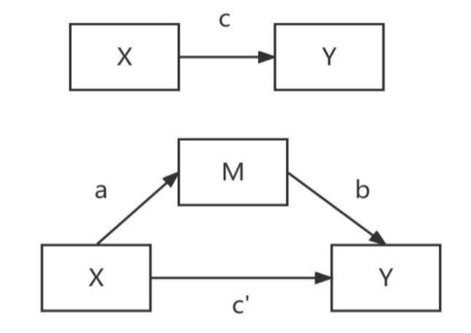
Results
- Influencing factors of HRQOL
The stage of tumor disease had a negative predictive effect on HRQOL.The length of hospitalization,while age had a positive predictive effect on HRQOL.
- correlation analysis
HRQOL was positively correlated with psychological resilience (r=0.477, P<0.01) and social support (r=0.307, P<0.01).There was a positive correlation between psychological resilience and social support (r=0.359, P<0.01).
- mediation effect test
Psychological resilience has a partial intermediary effect between social support and health-related quality of life (48.436%).
Figure 3 Theoretical model of Mesomeric effect

Slide 7
Discussion
Breast cancer survivors have gone through the treatment stage,over time, the trauma and psychological state of breast cancer have gradually recovered^{[5,6]}.
Most breast cancer survivors in urban areas in this study had more opportunities and conditions to obtain diversesocial support,The popularity of wechat in our country has made breast cancer survivors contact more social resources, have more ways to obtain health knowledge and resources, and promoted the recovery of self-health.
The better the Psychological resilience, the better the quality of life^{[7]}.
Good social support provides educational, physical, and emotional benefits to female breast cancer survivors and contributes to physical and psychological recovery ^{[8]}.
By enhancing Psychological resilience, breast cancer patients can mitigate the negative effects of physical, psychological, and social changes experienced during the course of the disease, and establish health-promoting behaviors that improve health-related quality of life ^{[9]} .

Slide 8
Conclusions
The overall psychological resilience of female survivors of breast cancer is general, the social support is at the medium level, and the health-related quality of life scores are good.
Medical staff should focus on breast cancer survivors who are young, have a high stage of tumor disease, and have been hospitalized for a short time.
Better psychological resilience and more social support for breast cancer survivors can lead to better health-related quality of life.
Health-care professionals should pay attention to the mediating role of Psychological resilience and look for available social and family resources to enhance the Psychological resilience of breast cancer survivors.

Slide 9
References
[1]Centers for Disease Control and Prevention. Breast cancer. (2016). Accessed April 22, 2016, from http://www.cdc.gov/cancer/breast/index.htm.
[2]Claudia Santuccia,Greta Cariolia,Paola Bertuccio et al. Progress in cancer mortality, incidence,and survival:a global overview[J].Eur J Cancer Prev,2020,29:367-381.
[3]Cheng Huilin,Sit Janet W H,Chan Carmen W H et al. Social support and quality of life among Chinese breast cancer survivors:findings from a mixed methods study[J].Eur J Oncol Nurs,2013,17:788-96.
[4]Robison LL,Demark-Wahnefried W. Cancer survivorship:focusing on future research opportunities.Cancer Epidemiol Biomarkers Prev,2011,20(10):1994-1995.
[5]Tu Pei-Chiung,Yeh Dah-Cherng,Hsieh Hui-Chen.Positive psychological changes after breast cancer diagnosis and treatment:The role of trait resilience and coping styles[J].Psychosoc Oncol,2020,38:156-170.
[6]DiSipio Tracey,Hayes Sandi,Newman Beth et al.Health-related quality of life 18 months after breast cancer:comparison with the general population of Queensland, Australia[J].Support Care Cancer,2008,16:1141-1150.
[7]Ristevska Dimitrovska G, Filov I, Rajchanovska D et al.Resilience and quality of life in breast cancer patients[J].Open Access Maced J Med Sci,2015,3(4):727-731.
[8]Toledo Gabriela,Ochoa Carol Y,Farias Albert J.Exploring the role of social support and adjuvant endocrine therapy use among breast cancer survivors[J].Support Care Cancer,2020,28: 271-278.
[9]Aizpurua-Perez Ibane,Perez-Tejada Joana.Resilience in women with breast cancer:A systematic review[J].Eur J Oncol Nurs,2020,49:101854.

Slide 10
Thank you for listening！

