Slide 1


Symptoms and Managements of Malignant Fungating Wounds in Patient with Cancer:
A Scoping Review
Dita Indriyati, S.Kep.,Ners.
Department of nursing, inpatient installation, Dharmais Cancer Hospital, Jakarta, Indonesia
Made Satya Nugraha Gautama, S.Kep.,Ns
Master of Nursing Program, Faculty of Medicine, Public Health, and Nursing, Universitas Gadjah Mada, Yogyakarta, Indonesia
Master in School of Nursing, College of Nursing, Taipei Medical University, Taipei, Taiwan

Slide 2

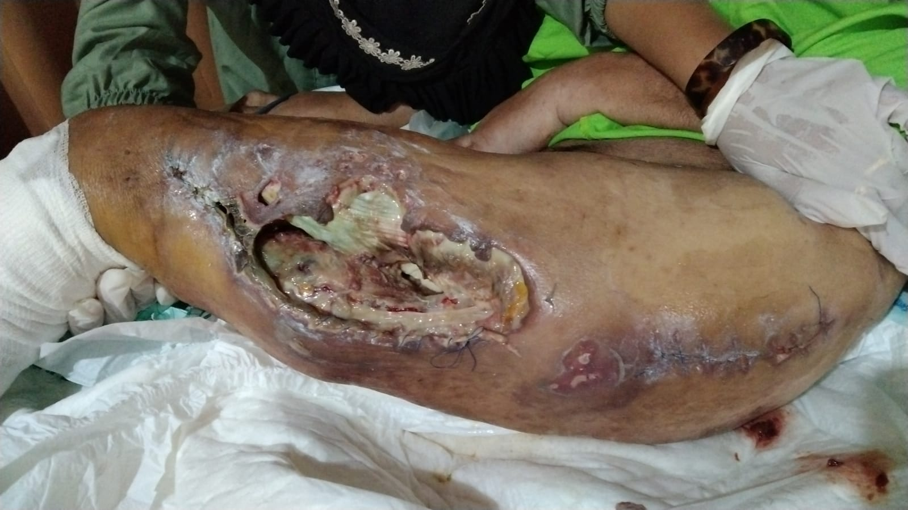
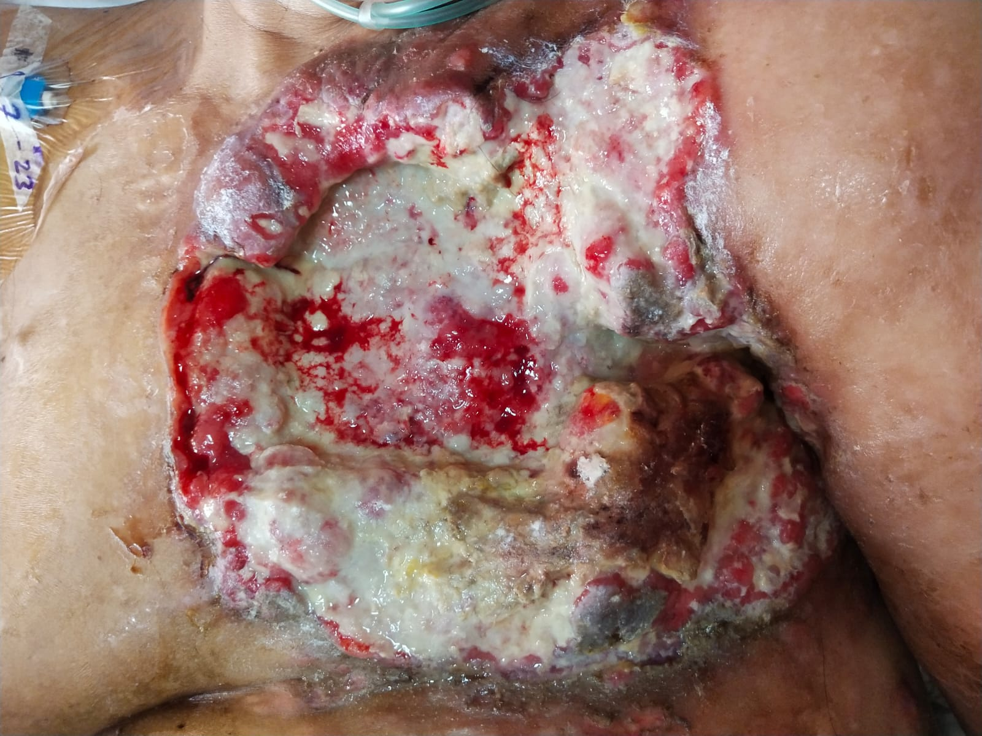
INTRODUCTION
Background
Malignant Fungating Wounds (MWFs) are complex chronic wounds (Ferreira et al.,2022)
Caused by the uncontrolled growth of malignant cells that break the skin's structure (Hoshi et al., 2019; Tilley et al., 2020)
4%–15% of cancer patients develop this type of injury (Firmino et al., 2020)
Primarily affect the breasts (62% to 66%), head and neck (24%) (EONS, 2015; Firmino et al., 2020)
This amount is underestimated since there is no population-based cancer register following the incidence of this condition (Furka et al., 2022)
The estimated life expectancy is about 6 to 12 months (Tilley et al., 2016; Lo et al.,2008)
Source: original picture

Slide 3
Cont.,
Research gaps
A evidence stated that patients with MFWs suffered multiple symptoms (Tilley et al., 2020)
The most frequently reported symptoms from patients with MFWs are physical symptoms (such as pain, odor, exudate) (Tilley et al., 2020; Raja et al., 2020) but inconsistently reported, including psychological symptoms that are still neglected (Robinson & Holloway, 2019).
Topical therapies for topical MFW-related pain management were identified for considerations in clinical practice (Ferreira et al.,2022)
Treatment options and current management of MFWs are varied but limited research has explored (Gethin et al.,2023)
Current study was needed to map and describe complex symptoms and management of MWFs in cancer patient

Slide 4
OBJECTIVES
The purpose of this study was to map and synthesize the existing literature on the symptoms and managements of cancer patients with MFWs, as well as to identify the existing gaps.

Slide 5
METHODS
Study design
A scoping review following PRISMA Extension for Scoping Reviews (PRISMA-ScR)
Eligibility criteria
Inclusion: Patient cancer with malignant wound (=> 18 age), published 2012 – 2023, English language, and quantitative/qualitative study
Exclusion: Acute wound, burn injury, pos-operative wound, systematic review, case report, protocol study, editorial, in vivo-invitro study, secondary data
Search strategy
Database: PubMed, ScienceDirect, and Scopus) and Google Scholar
Keywords: "cancer" and "malignant fungating wounds", "symptoms" and "management" or "intervention" or "treatment“
Review question (PCC framework)
What are the symptoms of MFW in cancer patients and what interventions are available to treat these symptoms?

Slide 6
RESULTS
Characteristics
14 out of the 1487 articles that entered the screening phase met the review criteria.
The majority of the included studies involved breast cancer patients ranging in age from 18 to 96 years old with various cancer stages (I–IV)

Slide 7
Cont.,
Main findings
Symptoms
Physical symptoms→ pain, exudate, edema, odor, bleeding, infection, necrosis
Intervention
Pharmacologic→ sulfadiazine silver-containing cream, metronidazole, silver, PHMB 0.1% solution, hemostatic dressings, hemostatic solutions, Limb-salvage surgery, Analgesic medications, and debulking procedures
Non-pharmachological→ PEBO approach for wound dressing, normal saline wet dressing, modern dressing
Psychological, Psychosocial, Spiritual→ depression, anxiety, poor quality of life

Slide 8
CONCLUSION
Physical symptoms impacted the quality of life of cancer patients with MFWs
There are 2 kind of physical symptoms:
Subjective → Pain
Objective → odor, edema, exudate, infection, and necrosis
The applied interventions emphasized wound symptom management
Cancer patients with MFW required multidisciplinary approach that focused on their symptoms to enhance their quality of life

Slide 9
REFERENCES
Tamai, N., Mugita, Y., Ikeda, M., & Sanada, H. (2016). The relationship between malignant wound status and pain in breast cancer patients. European Journal of Oncology Nursing, 24, 8-12.
Watanabe, K., Shimo, A., Tsugawa, K., Tokuda, Y., Yamauchi, H., Miyai, E., ... & Nakamura, S. (2016). Safe and effective deodorization of malodorous fungating tumors using topical metronidazole 0.75% gel (GK567): a multicenter, open-label, phase III study (RDT. 07. SRE. 27013). Supportive Care in Cancer, 24, 2583-2590.
Kalemikerakis, J., Vardaki, Z., Fouka, G., Vlachou, E., Gkovina, U., Kosma, E., & Dionyssopoulos, A. (2012). Comparison of foam dressings with silver versus foam dressings without silver in the care of malodorous malignant fungating wounds. J BUON, 17(3), 560-564.
Villela-Castro, D. L., de Gouveia Santos, V. L. C., & Woo, K. (2018). Polyhexanide versus metronidazole for odor management in malignant (fungating) wounds: a double-blinded, randomized, clinical trial. Journal of Wound Ostomy & Continence Nursing, 45(5), 413-418.
Peng, L., & Dai, Y. (2020). Effect of metronidazole combined with autolytic debridement for the management of malignant wound malodor. Journal of International Medical Research, 48(4), 0300060519889746.
Nicodème, M., Dureau, S., Chéron, M., Kriegel, I., Trenchand, M., Bauër, P., & Fromantin, I. (2021). Frequency and management of hemorrhagic malignant wounds: a retrospective, single-center, observational study. Journal of Pain and Symptom Management, 62(1), 134-140
Janowska, A., Davini, G., Dini, V., Iannone, M., Morganti, R., & Romanelli, M. (2021). Local management of malignant and unresectable fungating wounds: PEBO assessment. The International Journal of Lower Extremity Wounds, 15347346211053478
Tang, J., Qin, F. H., Chen, Y., Liu, Y., Nong, L., Zhong, W. N., & Li, L. Q. (2020). Topical oxygen therapy can reduce related symptoms of malignant fungating wounds in breast cancer: a retrospective observational case series study. INTERNATIONAL JOURNAL OF CLINICAL AND EXPERIMENTAL MEDICINE, 13(11), 8526-8534
Lo, S. F., Hayter, M., Hu, W. Y., Tai, C. Y., Hsu, M. Y., & Li, Y. F. (2012). Symptom burden and quality of life in patients with malignant fungating wounds. Journal of Advanced Nursing, 68(6), 1312-1321
Okajima, K., Kobayashi, H., Okuma, T., Arai, S., Zhang, L., Hirai, T., ... & Tanaka, S. (2021). Prognosis and surgical outcome of soft tissue sarcoma with malignant fungating wounds. Japanese Journal of Clinical Oncology, 51(1), 78-84
Patel, B. C., Ostwal, S., Sanghavi, P. R., Joshi, G., & Singh, R. (2018). Management of malignant wound myiasis with ivermectin, albendazole, and clindamycin (triple therapy) in advanced head-and-neck cancer patients: a prospective observational study. Indian Journal of Palliative Care, 24(4), 459
Probst, S., Arber, A., Trojan, A., & Faithfull, S. (2012). Caring for a loved one with a malignant fungating wound. Supportive Care in Cancer, 20, 3065-3070
Kondra, K., Pekcan, A., Stanton, E., Cook, A. D., Jimenez, C., Aronowitz, A., ... & Aronowitz, J. A. (2022). Fungating Malignancies: Management of a Distinct Wound Entity. Advances in Skin & Wound Care, 35(12), 646-652
Firmino, F., da Costa Ferreira, S. A., Franck, E. M., de Queiroz, W. M. S., Castro, D. V., Nogueira, P. C., & Santos, V. L. C. G. (2020). Malignant wounds in hospitalized oncology patients: prevalence, characteristics, and associated factors. Plastic and Aesthetic Nursing, 40(3), 138-144

Slide 10
Thank you for your attention

