Slide 1


An Experience of Nurse led Central Venous Access Clinic in Tertiary Cancer Care Hospital
Mrs. Irene Ruben Sunder
TATA MEMORIAL HOSPITAL, MUMBAI. INDIA

Slide 2

INTRODUCTION
Central venous catheters are commonly indicated in oncology setting. Patients who are receiving aggressive anti-cancer treatment needs intravenous administration of chemotherapy, frequent blood components, antibiotics and parenteral nutrition.
In our institute physicians were primarily responsible for PICC insertion and care and maintenance. However due to increasing complications, it was thought to assign this responsibility to nurses.
Nurse led central venous access devices (CVAD) clinic has been established in the year 1991, with the purpose for better communications, evidence-based practice and improved quality of life of the patients.
In our institute, Groshong® PICC 4french, single lumen catheter is used extensively in cancer patients.
These PICCs are inserted by trained nurses without ultrasound guidance in pediatric and adult patients.

Slide 3
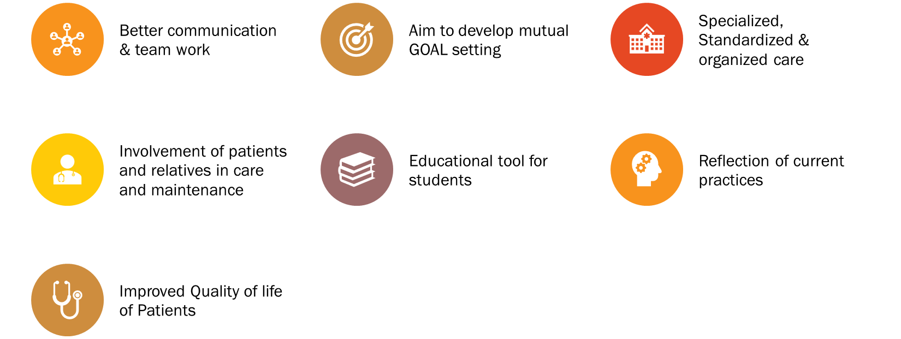
Need Of Special Clinic

Slide 4
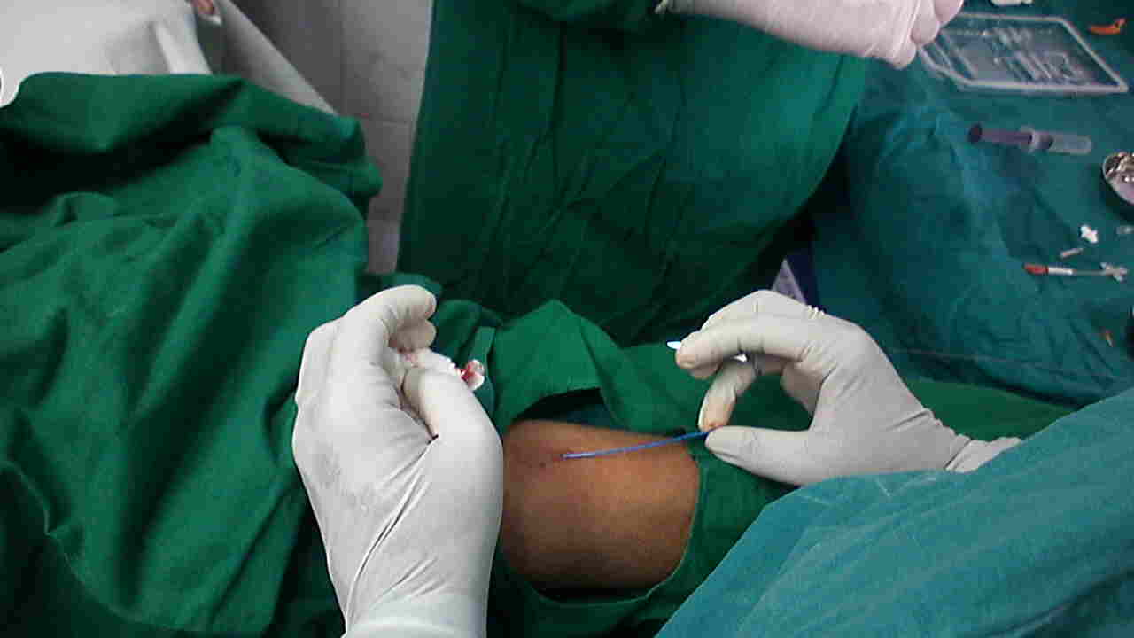
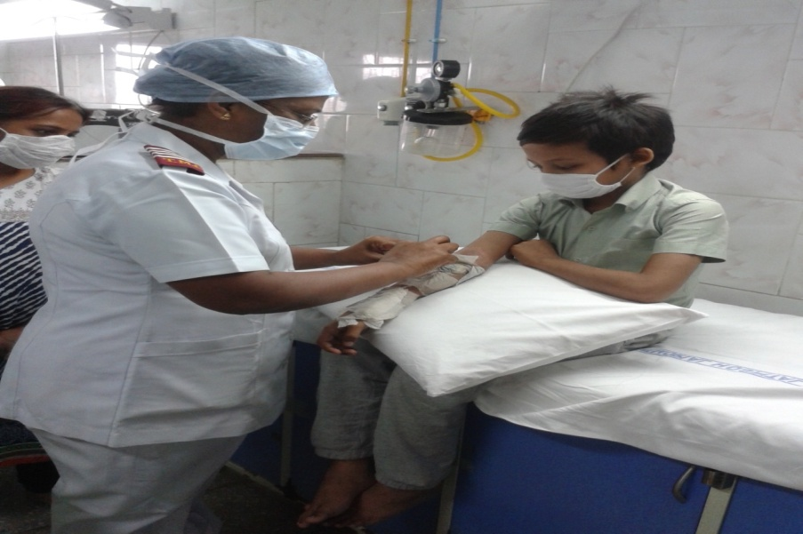
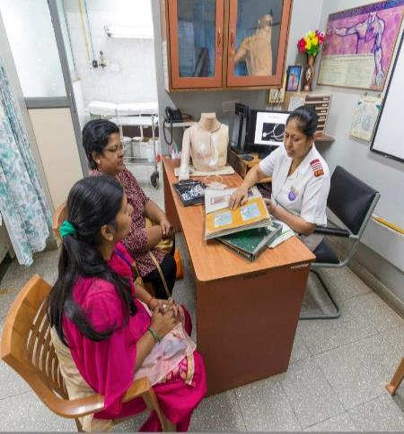
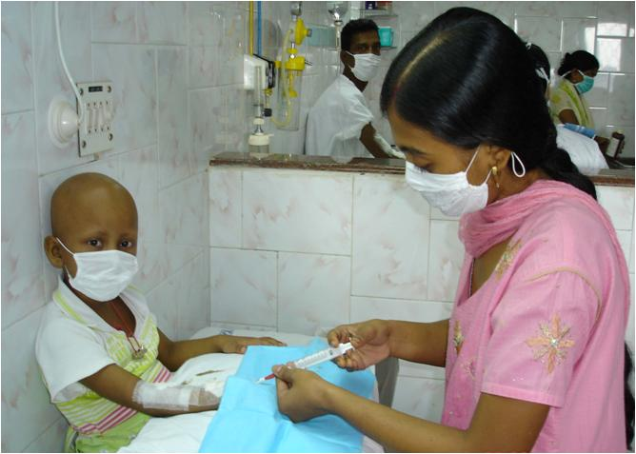
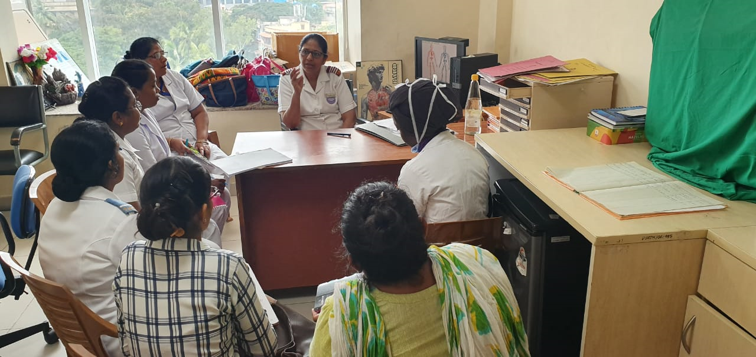
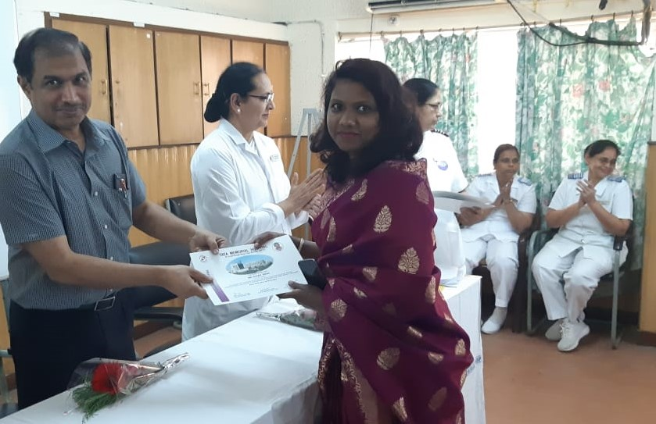
Activities Of CVAD Clinic
TEACHING & DEMONSTRATION
COUNSELLING
PICC INSERTION
RETURN DEMONSTRATION
TEACHING
CERTIFICATION

Slide 5
Objectives
To assess PICCs related complications
To find out effectiveness, low cost and improvement of quality of life the patients

Slide 6
Methods
Before PICC insertion patient and close family member are counselled about importance of PICC line, briefly explain insertion procedure, uses of PICC line, daily activities performed with PICC line, need of site care, lumen patency by flushing and if care was not taken possible complications
Groshong® PICC insertion is done under strict aseptic technique by trained nurses without ultrasound guidance. PICC tip is confirmed by chest x-ray.
Site is cleaned with 2% chlorohexidine gluconate and 70% ethanol contain solution. No sting skin barrier is applied. Then CHG impregnated transparent dressing applied.
Lumen flushing is done with 0.9% normal saline pusiflush syringe. Needleless connector is scrubbed with antiseptic solution.
Dressing and flushing is done once in a week.
Patient’s close family member is taught about care and maintenance (dressing flushing)
Patient’s data is collecting from insertion to the removal of PICC.

Slide 7
Result
JANUARY 2022 TO MARCH 2022
427
2

Slide 8
Disease Distribution
N=234
N=164

Slide 9
Result
N=234
Total Catheter Access Days – 39788
Median Catheter Access Days- 170
Range -5 to 360 days
Age Range from 1year to 76 years

Slide 10
Result
Infectious Complications
N=234
Type | No. | Cure | Removal | %
Site Infection | 25 | 16 | 5 | 10.6
CLABSI | 2 | 2 | 0 | 0.85
Septic Phlebitis | 1 | 0 | 1 | 0.42
Dermatitis | 102 | 92 | 10 | 43.5

Slide 11
Result
Non- Infectious Complications
N=234
Type | Number | Resolved | Removal | %
Mechanical Phlebitis | 8 | 8 | 0 | 3.4
Block | 2 | 2 | 0 | 0.85
Fracture or Tear in catheter | 4 | 4 | 0 | 1.7
Dislodgement | 10 | 0 | 10 | 4.27
Block & Fracture | 3 | 3 | 0 | 1.28

Slide 12
Result
PICC Removal
N=234
Reasons | No | %
Infectious Complications | 5 | 2.1
Non- Infectious Complications | 10 | 4.2
Completed Treatment | 200 | 85.4
Resistant to Treatment | 19 | 8.1

Slide 13
Discussion
Primarily PICC insertion, care and maintenance is done by a physician. There were no standard protocol followed.
In the year 1991, nurse led CVAD clinic was established. First all Standard Operative Procedure were made.
Patients who are unable to visit the CVAD clinic frequently due to long distances are provided with education on PICC care and maintenance. It was observed that self-efficacy interventions effectively reduce complications and alleviate financial burdens associated with treatment.
PICC complications observed like site infection 10.5% (N=25), CLABSI 0.85% (N=2), Contact dermatitis 43.5% (N=102), Mechanical Phlebitis 3.4% (N=8), Fracture of PICC 1.7% (N=1.7) and dislodgement 4.2% (N=10).
Out of all the PICC placements, 94% were removed upon completion of treatment, while the remaining 6% were removed due to complications.

Slide 14
Conclusion
Using PICC in cancer patients is not associated with an elevated risk of complications.
Nurse led PICC insertion and care and maintenance has significantly reduced complications.
Particular attention should be given to early identification of complications and educations to patient.
Some chemotherapy drugs and patients’ morbidities are independent risk factor for local skin irritation.

Slide 15
Refrences
Evan Alexandrou et al.Nurse-led central catheter insertion-procedural characteristics and outcomes of three intensive care based catheter placement services, Volume 49: Issue2 , February2012, International Journal of Nursing Studies, Pages162-168
Evan Alexandrou et al. Estabilishing a Nurse –led Central Venous Catheter Insertion Service, Volume15: Issue1, 2010, Journal of the Association for Vascular access, Pages21-27
Philippe Eggimann et al. Sustained reduction of catheter-associated blood stream infections with enhancement of catheter bundle by chlorohexidine dressings over 11years,Volume 45:2019 Intensive Care Medicine, Pages 823-833
Xioman Lio et al. Risk factors for peripherally inserted central catheter(PICC)-associated infections in patients receiving chemotherapy and the preventive effect of a self-efficacy intervention program: a randomized controlled trail, Volume 10: NO 9,
September 2021, Annals of Palliative Medicine, Pages 9398-9405

Slide 16


Thank You!

