Slide 1



Effect of early postoperative coffee consumption on the recovery of intestinal function in patients undergoing cervical cancer surgery under the ERAS concept
Obstetrics and Gynecology, First Affiliated Hospital
of Army Military Medical University
Wang Yan, Wu Zhimin, Wang Yanzhou, Liang Zhiqing
Tel:15215163196

Slide 2



Case Manager
Senior Health Manager
Licensed Pharmacist in 2015 and ISPN in 2023
First author of 5 papers, 2 in statistical source journals
5 utility model patents
one presentation at an international conference and and two poster presentations
5.12 Florence Nightingale type nurse,
annual advanced individual
Honored as an Outstanding Nurse on several occasions
Wang Yan
（王艳）

Slide 3
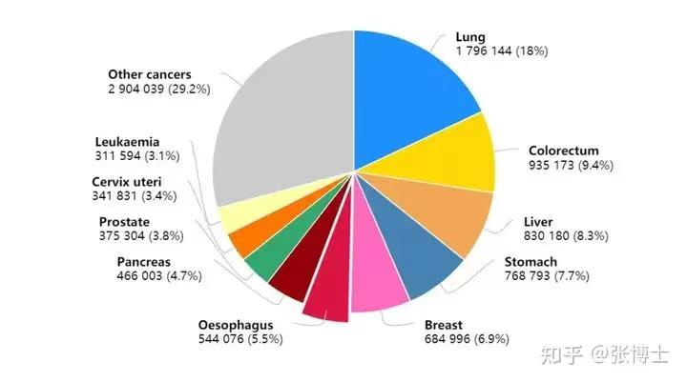
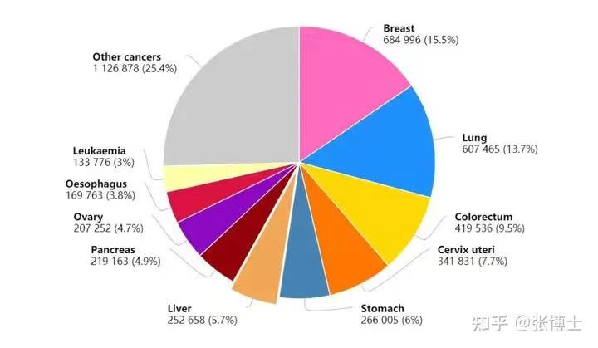
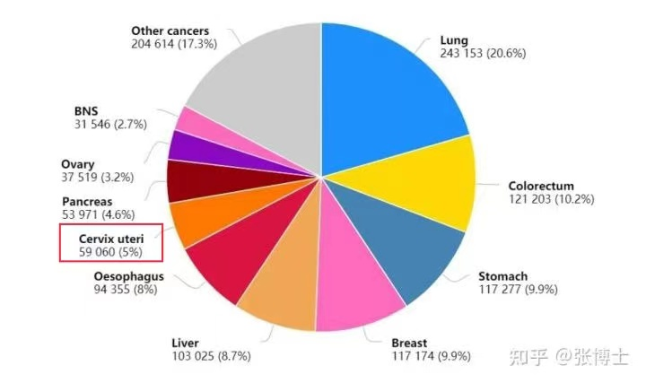
I. Background of the study
Top 10 cancer types for global cancer deaths in 2020
Top 10 Cancer Types for Female Cancer Deaths Worldwide in 2020
Top 10 cancer types for female cancer deaths in China in 2020
In 2020, there will be 2.09 million new cancer cases and 1.18 million cancer deaths among women in China, accounting for 39% of the total.^{[1]} ，And the incidence of cervical cancer is rising every year.^{[2]} 。
Surgery is one of the main treatments, which has the advantages of reducing tumor load and completing surgical staging^{[3]} . However, it also seriously affects the recovery of postoperative intestinal function.
[1] https://www.iarc.fr/fag/latest-global-cancer.
[2] WANG Yu,SONG Shufang,LIU Feng. Research progress on epidemiologic characteristics and high risk factors for the development of cervical cancer in China[J]. China Maternal and Child Health,2019,34(5):1206-1208.
[3] Song N Gao Y Therapeutic value of selective lymphasenectomy in interval debulking surgery for stageIlIc and IV epithelial ovarian cancer ]. Int J Gynecol Cancer, 2019,29(4):761-767

Slide 4
I. Background to the study
Accelerated recovery after surgery (ERAS) refers to the use of a series of safe and feasible measures with evidence-based medical evidence around its core components (diet, activity, psychology, pain, plumbing, etc.) during the perioperative period in order to promote the early recovery of surgical patients^{[3~4]} . Therefore, how to improve or enrich the ERAS program to promote the recovery of gastrointestinal function is an important topic today, and is also the research direction of this study.
Coffee is common and readily available, and the 2019 International ERAS Society guidelines for gynecology/gynecologic oncology have recommended that coffee consumption may shorten the time to recovery of postoperative bowel function, but at this stage, there are still few clinically randomized studies at home and abroad on this. Therefore, this study aims to provide clinical evidence for early bowel function recovery through the implementation of clinical randomized controlled practice in cervical cancer surgery patients.
[3] Kehlet H. Multimodal approach to control postoperative pathophysiology and rehabilitation Jl. Br J Anaesth.199778(5):606-617.
[4] Bisch S P, Jago C A, Kalogera E, et al. Outcomes of enhanced recovery after surgery (ERAS)systematic review and meta-analysis[Jl. GynecolOncolingynecologiconcology - A2021.161(1):46-55

Slide 5
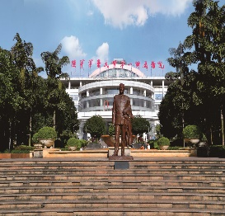
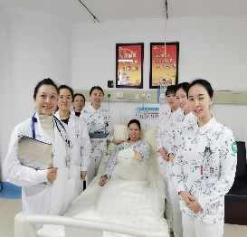
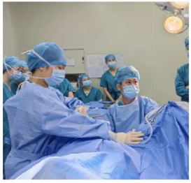
I. Basis and purpose of the study
Relying on a comprehensive and modernized large-scale tertiary hospital
integrating medical treatment, teaching and scientific research
Based on Chongqing gynecology nurse training base
Escorted by a team of rapid gynecologic rehabilitation nurses
The number of gynecological cervical cancer patients hospitalized
in the last 5 years is about 600/year
Purpose of the study:
To investigate the effect of coffee consumption in the early postoperative period
on the recovery of bowel function in patients undergoing surgery for cervical cancer.

Slide 6
II. Study information
research target
健 、完善地实施糖尿病健康教育，从而有助于糖尿病的治、
Timing：1/2/2022~31/12/2022 Surgery: Laparoscopic radical surgery for cervical cancer.
Grouping methodology:RCT, experimental group (early postoperative coffee drinking group, 55 cases) and control group (immediate postoperative eating group, 55 cases), others: signed informed consent.
Table 1: Comparison of general information of the two groups of patients
groups
body mass index (BMI)（kg/m2）
History of abdominal surgery(n)
Coffee Drinking History (n)
Duration of surgery
（min）
Intraoperative bleeding （ml）
n
Age/years
control subjects
55
49.98±10.39
25.0±3.3
11
2
175.0±54.4
100(100-200)
experimental group
55
50.18±7.81
24.3±3.4
13
6
176.0±51.4
150(100-300)
statistical quantity
z=-0.260
t=1.226
x²=1.029
-
t=-0.976
-
P-value
0.795
0.224
0.310
0.617
0.332
0.217

Slide 7
III. Study methods
1、 methods
健 、完善地实施糖尿病健康教育，从而有助于糖尿病的治、
Both groups of patients were managed in a homogeneous way before surgery, such as bowel preparation, pain management, thromboprophylaxis, etc, and were instructed in pre-hospital prehabilitation functional exercises.
Intraoperative goal-directed fluid therapy management in both groups; optimized anesthesia regimen; intraoperative temperature >36°C.
Routine nursing care was implemented in both groups after surgery, such as plumbing care, instruction in bed and underbed activities (ERAS health exercises), wound and pain care, and so on.
纳入
标准
排除
标准

Slide 8
III. Study methods
1、 methods
健 、完善地实施糖尿病健康教育，从而有助于糖尿病的治、
Immediate postoperative feeding, that is, the patient woke up after surgery back to the ward immediately after the start of eating, (the first 2h can eat warm water 50-250ml, divided into 5-10 times oral intake, each time the interval of 10-30min; 2-4h can eat 250-500ml of liquid food, divided into 3-5 times intake, each time the interval of 10-30min such as rice broth, warm water, non-dregs of fruit juice, etc.) until the postoperative 24h The patient is on a liquid diet within the first 24h.
control group
Coffee was consumed in the early postoperative period, i.e., 150-200 ml of coffee was given orally 2h, 6h, and 18h after the patients were awakened, and each time it was consumed within 15~20min. Patients can eat other fluids but not containing caffeine or tea or soda type drinks in 19h~24h postoperatively.
健 、完善地实施糖尿病健康教育，从而有助于糖尿病的治、。
experimental
group
study group

Slide 9
III. Study methods
健 、完善地实施糖尿病健康教育，从而有助于糖尿病的治、
2、Observation indicators
纳入
标准
Recovery of postoperative bowel function: time to first anal evacuation, time to first bowel movement, time to tolerate solids.
Patients were compared for 24h postoperative pain levels (VAS score), CRP values, and sleep quality (PSQI score).
Patients' average postoperative hospitalization days and complication rates.
排除
标准

Slide 10
III. Study methods
健 、完善地实施糖尿病健康教育，从而有助于糖尿病的治、
3、Statistical methods
SPSS 22.0 software was applied for statistical analysis. Measurement information was expressed as mean ± standard deviation, and independent samples t-test and non-parametric test were used for comparison between the groups, while counting information was expressed as number of cases and percentage, and χ² test was used for comparison between the groups, and the difference was statistically significant at P＜0.05.
纳入
标准
排除
标准

Slide 11
IV. Findings
健 、完善地实施糖尿病健康教育，从而有助于糖尿病的治、
Table 2: Comparison of gastrointestinal function recovery and average postoperative hospitalization days between the two groups of patients（‾x±s）[n（%）]
Average postoperative Hospital days/d
groups
Time to first anal defecation/h
First bowel movement Time/h
First solid tolerance time/h
n
control subjects
55
16.3± 7.442
28.68±10.99
58.68±10.39
9.47±2.30
experimental group
55
14.5 ±6.75
24.38± 9.22
54.12±9.16
7.72±1.28
P-value
＜0.05
＜0.05
＜0.05
＜0.05

Slide 12
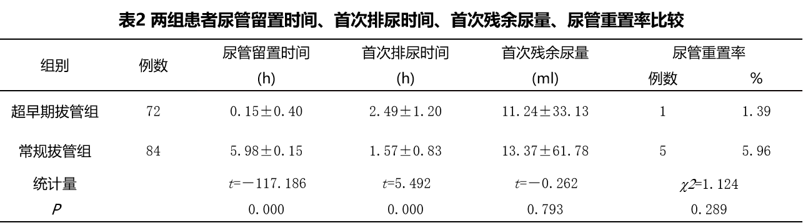
IV. Findings
健 、完善地实施糖尿病健康教育，从而有助于糖尿病的治、
Table 3: Comparison of 24h postoperative VAS scores, CRP values, PSQI scores between the two groups of patients（‾x±s,分)
groups
n
VAS score
CRP value
PSQI score
9.47±2.30
control subjects
55
4.5(3-6)
46.20±14.38
8.81±3.36
experimental group
55
3.5(2-5)
42.88±11.30
7.68±1.61
P-value
＜0.05
＜0.05
＜0.05
There were no 30-day admission rates or postoperative complications in either group.

Slide 13
V. Discussion
健 、完善地实施糖尿病健康教育，从而有助于糖尿病的治、
Early postoperative coffee consumption reduces the occurrence of postoperative gastrointestinal complications and improves the quality of recovery. Studies have reported ^{[5]} that caffeine can stimulate colonic motility by promoting gastrin secretion and antagonizing adenosine receptors, thus promoting gastrointestinal motility and reducing the occurrence of corresponding complications and improving the quality of recovery.
On the other hand, drinking coffee in the early postoperative period can reduce the pain level of patients and increase their postoperative comfort and satisfaction .Studies have reported[6] that caffeine and its component chlorogenic acid can inhibit the production of tumor necrosis factor-a and interleukin-6, which can produce anti-inflammatory and inhibit the effect of edema, and thus reduce pain.
[5] PJ. Boekema, M. Samsom, G.P. van Berge Henegouwen, A.J. Smout, Coffee and gastrointestinal function: facts and fiction, A review, Scand. J. Gastroenterol. 230(1999) 35-39.https://doi org/10.1080 003655299750025525.
[6] Piric M,Pasic F, Rifatbegovic Z, et al. The Effects of Drinking Coffee While Recovening from Colon and Rectal Resecton Surgery[J]. Med Arch, 2015,69(6):357-361

Slide 14
VI. Conclusion
健 、完善地实施糖尿病健康教育，从而有助于糖尿病的治、
In conclusion, firstly, drinking coffee in the early postoperative period is safe and effective; secondly, it not only reduces the level of postoperative pain of the patients, promotes earlier recovery of their intestinal function and increases the patients' comfort in recovery, but also shortens their hospitalization time and reduces the cost of their medical treatment; and thirdly, it meets the patients' high expectation of the quality of postoperative recovery, which is worthy of clinical reference and application.

Slide 15
THANK YOU
Obstetrics and Gynecology, First Affiliated Hospital of Army Military Medical University

